Slide 1
Socrates
Critical Design Review

Slide 2
Agenda
Introduction
Motivation
Approach
Budget
Design
Standards
FMEA
Conclusion
Individual Reports
Charlie D

Slide 3
Introduction
Charlie D
Communications
Tim Kukowski
Ben Setterholm
Team Lead/Structure
Charles Denis
ADNCS
Jacob Gustafson
Brian Hanson
Nicholas Sloan
Power Management
Ethan Arendt
Nicholas Janak
Justin Seifert

Slide 4
Motivation
Charlie D
SOCRATES:
Signal
Opportunity
CubeSat
Ranging
And
Timing
Experiment
System

Slide 5
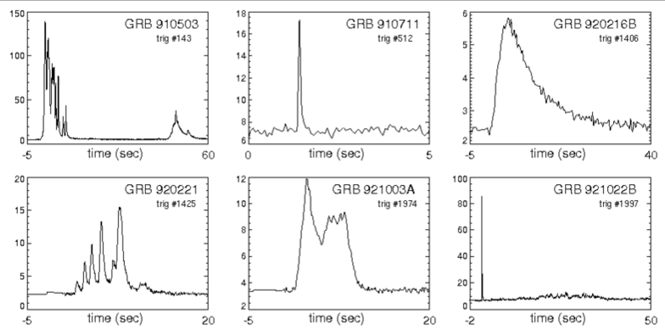
Motivation
Charlie D
Payload
Gamma Ray Incident Detector (GRID)
What GRID does?
Detect gamma ray events to conceptually prove deep space navigation concepts
This figures shows six examples of known Gamma Ray bursts from our universe. The data in the plots represents the relation between Kilo-Electron Volts and Seconds in time.

Slide 6
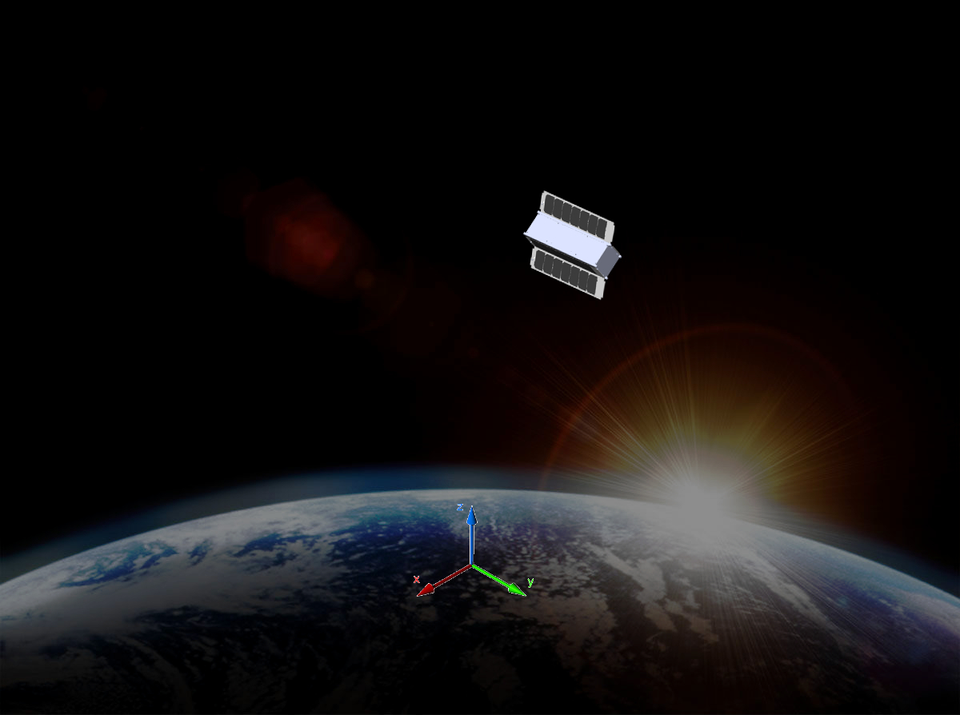
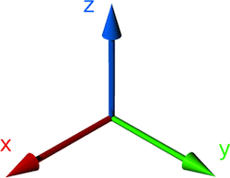
CONOPS
X
Charlie D
SOCRATES
Operating in LEO (~410km/~255 miles)
Operating under photovoltaic power
Continuous environmental polling
Triggered by GRB
GRID data
GPS “best XYZ” and velocities
Attitude vector
Real time
Radio Communication
Transfers GRB telemetry to ground stations

Slide 7
Motivation
Tim K
Requirements
The CubeSat shall determine and relay a relative position solution (i.e., relative to the formation) with an accuracy of 10 meters (1 standard deviation)
The CubeSat shall determine and relay a relative attitude solution with an accuracy of 10 mRad.
The CubeSat shall maintain a clock offset or timing accuracy (relative to the formation) better than 10 µs.

Slide 8
Motivation
Tim K
Derived Requirements
Shall accept “GRID” as a payload
Supplies payload with power (5Whr)
Communicates with payload (via CAN bus)
Provides GRID with environmental data (time, attitude, position)
Compiles and transmits data from GRID to ground network
Shall meet NASA CubeSat Launch Initiative (NCLI) requirements
Notes:
NASA CubeSat Launch Initiative - http://www.nasa.gov/pdf/627972main_LSP-REQ-317_01A.pdf

Slide 9
Design Approach
Tim K
Goals
Successfully carry GRID into LEO
Utilize subsystems to support GRID and transmit data
“Off-the-Shelf”
Focus on data rather than hardware
Proven space heritage
Corporate support for products
Subteams
Individuals become specialists for their subsystem

Slide 10
Purchases
Jake G
Flight Computer
GPS
Receiver Unit
Antenna
Attitude
Gyroscopes
Passive Magnetic Bar
Power
Power Management Board
Batteries
Deployable Solar Panels
Radio
Radio Unit (provided by Aerospace Corp)
Antenna (Patch)
Structure
Materials
Insulation
Cabling, etc

Slide 11
Budget
Jake G
Initial Budget
Lower ($50,000)
Passive Attitude Control
Solar Panels on Faces
Middle ($75,000)
Passive Attitude Control
Deployed Solar Panels
Upper ($100,000)
Active Attitude Control
Deployed Solar Panels
NASA Proposal

Slide 12
Final Budget
X
Item | Model | Source | Cost
Flight Computer | A712D | GOMSpace | $5,400
GPS receiver | OEM615 | Novatel | $6,000
GPS Antenna | Single Frequency MircoStrip | Antdevco | $5,000
Batteries | NanoPower BPX | GOMSpace | $6,200
Power Management Board | P31us | GOMSpace | $6,200
Radio | MM2-TTL | Freewave | $1,500*
Antenna | CS-CPUT-STX-02 | ClydeSpace | $4,725
Deployable Solar Panels | SP-L-DD1S3U-0039 | ClydeSpace | $40,300**
Gyroscopes | ITG-3050 | InvenSense Inc | $5
Structure | N/A | Century College | $1,200
Passive Attitude Magnet | ? | ? | ?
Final Cost: $75,030
*Provided free of Cost from AeroSpace Corp.
** Denotes the cost of 2

Slide 13
Design - Data Packet
Charlie D
GRID
GRID will run on a FIFO memory buffer
When a GRB is realized GRID will trigger the flight computer to store data to dedicated memory for beginning at -1min and +3 min from time of trigger.
This is known as our “packet”
GPS
GPS will run on a FIFO memory buffer
Flight computer trigger stores GPS best XYZ and velocity related to the start time of the packet
Knowing orbital elements we know the following positions of SOCRATES through the duration of the packet
End time GPS best XYZ and velocity is stored to calculate drift of measurements if applicable.
Attitude
Attitude is consistently calculated by the flight computer and stored in an accessible memory location
Flight computer trigger stores attitude at the start time and 15 second intervals through the packet duration.
Time
System time delay will be monitored as the difference between flight computer time (RTC) and GPS time
When difference > 10µs the flight computer real time clock is reset to GPS time.

Slide 14

Design - Data
Charlie D
Packet size per GRB
GRID = $\left(\frac{8 bit}{10µs}\right)×\left(\frac{1×{10}^{6}µs}{1 min}\right)×4 min×\left(\frac{1MB}{1048.576 bits}\right)=3051.8kB$
GPS = $\left(1064 bits\right)×\left(1t_{s}+1t_{f}\right)×\left(\frac{1MB}{1048.576 bits}\right)=2kB$
Attitude = $\left(36 bytes\right)×\left(\frac{4 reads}{1 min}\right)×4 min×\left(\frac{1kB}{1048.576 bits}\right)=0.5493kB$
Total = GRID + GPS + Attitude = ~3.06MB per event.
Packets will be stored onboard flight computer
Packets will be transmitted with error checking to ground network when available.
Packets will then be released for memory consideration.

Slide 15
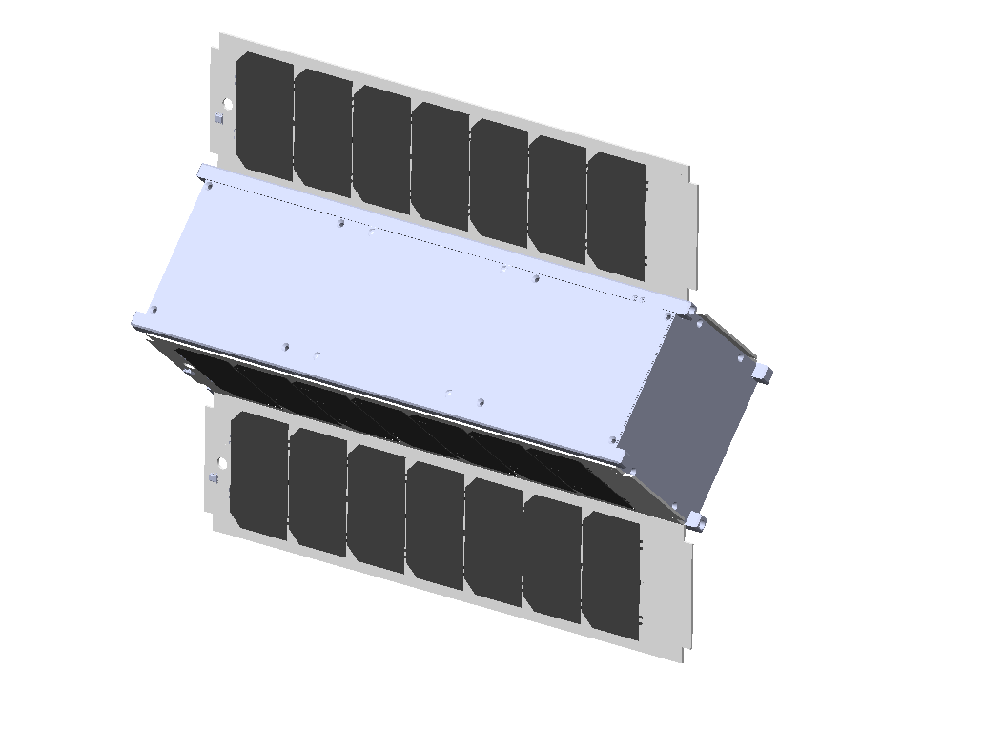
Design - Model
Charlie D

Slide 16
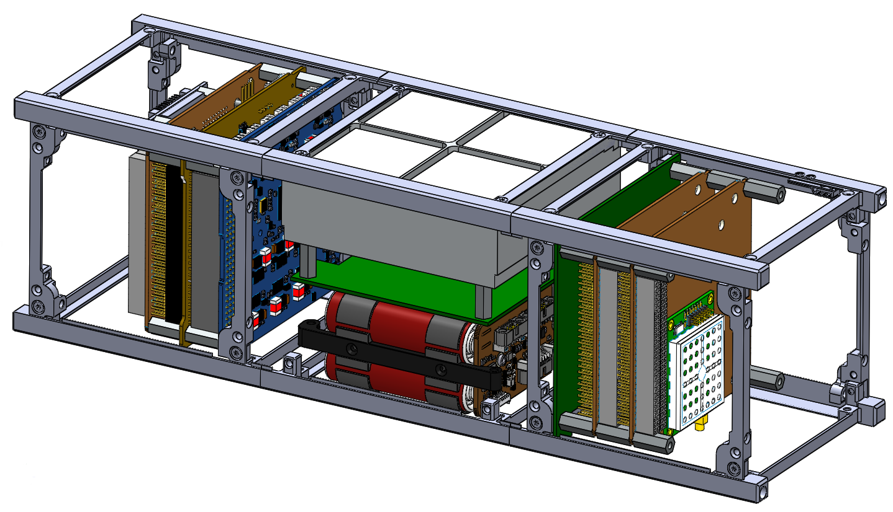
Design - Model
Charlie D

Slide 17
Design - Structure
X
Charlie D
Century College to Manufacture to Specifications
Sub Contracted by UMN

Slide 18
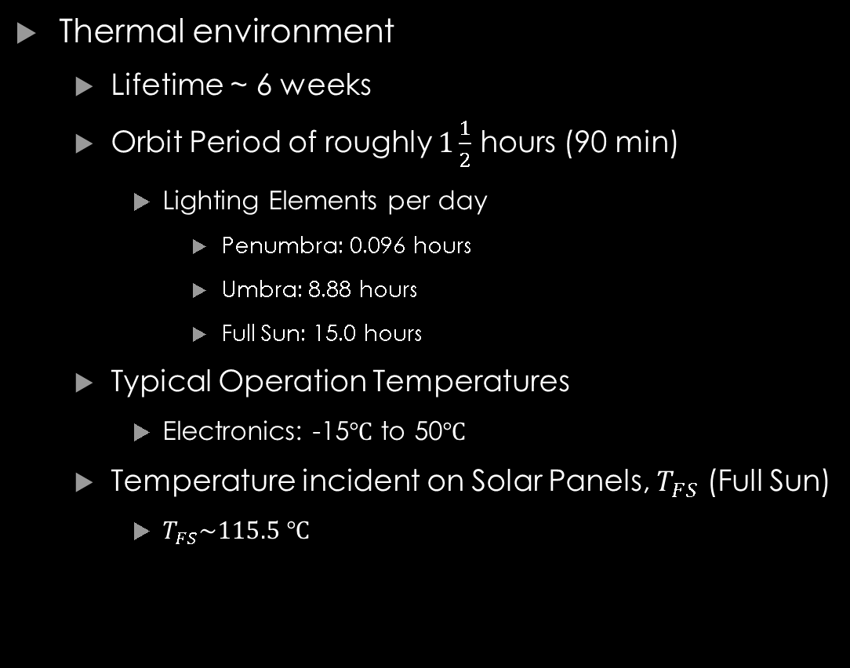
Design - Structure
Nick J
Thermal environment
Lifetime ~ 6 weeks
Orbit Period of roughly $1\frac{1}{2}$ hours (90 min)
Lighting Elements per day
Penumbra: 0.096 hours
Umbra: 8.88 hours
Full Sun: 15.0 hours
Typical Operation Temperatures
Electronics: -15$℃$ to 50$℃$
Temperature incident on Solar Panels, $T_{FS}$ (Full Sun)
$T_{FS}\sim 115.5 ℃$
Earth
Full Sunlight
Penumbra
Umbra

Slide 19

Design - Structure
Nick J
Solar Panels: Used as heat shielding
Absorptivity, $α=0.805$
Emissivity, $ε=0.825$
$β=\frac{α}{ε}=0.975$
A high $β$ value is indicative of the surface being warm, and hence, a good absorber
A low $β$ value is indicative of the surface being cool, and hence, a good radiator
Below the solar panels, the body of SOCRATES will be painted white - Passive
White coating helps to decrease the amount of thermal energy absorbed
$α=0.22, ε=0.88$
Internally, the surfaces will be silvered to refract radiation and keep the electronics cool
$α=0.07, ε=0.78$

Slide 20
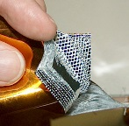
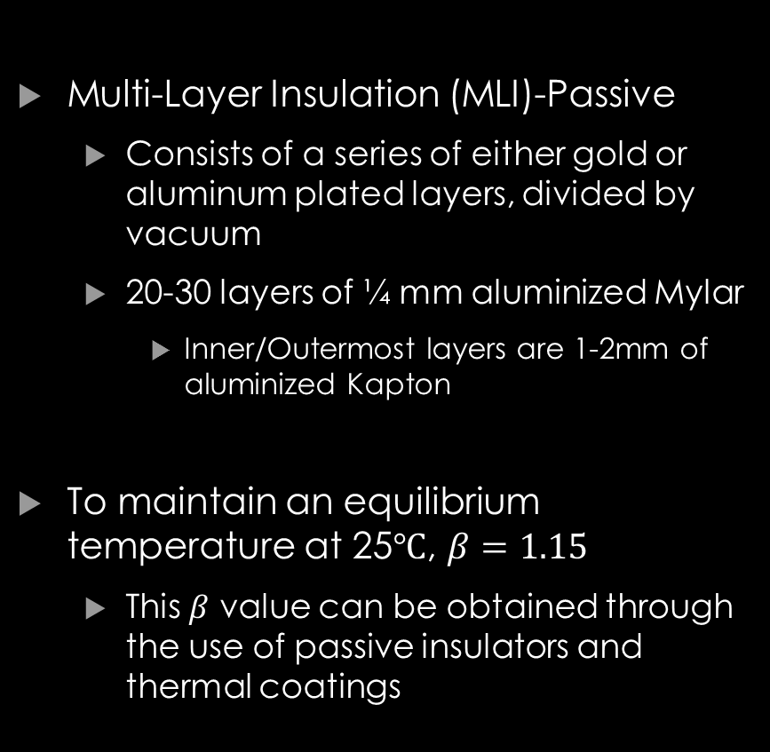
Design - Structure
Nick J
Multi-Layer Insulation (MLI)-Passive
Consists of a series of either gold or aluminum plated layers, divided by vacuum
20-30 layers of ¼ mm aluminized Mylar
Inner/Outermost layers are 1-2mm of aluminized Kapton
To maintain an equilibrium temperature at 25$℃$, $β=1.15$
This $β$ value can be obtained through the use of passive insulators and thermal coatings

Slide 21
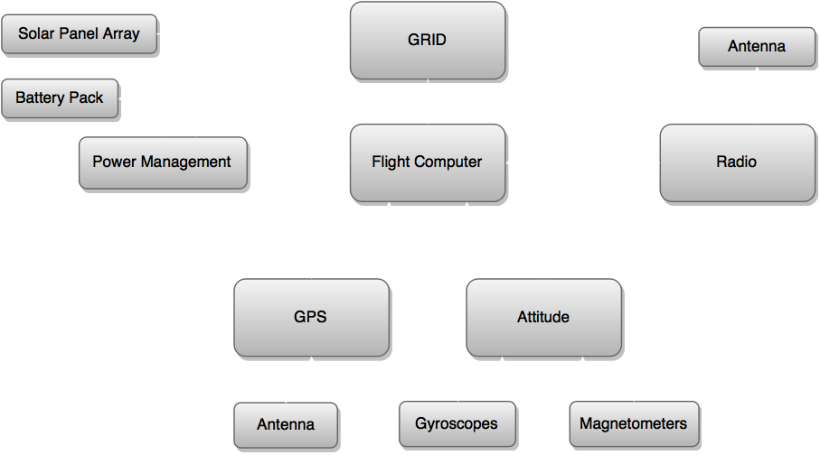
Design – Block Diagram

Slide 22
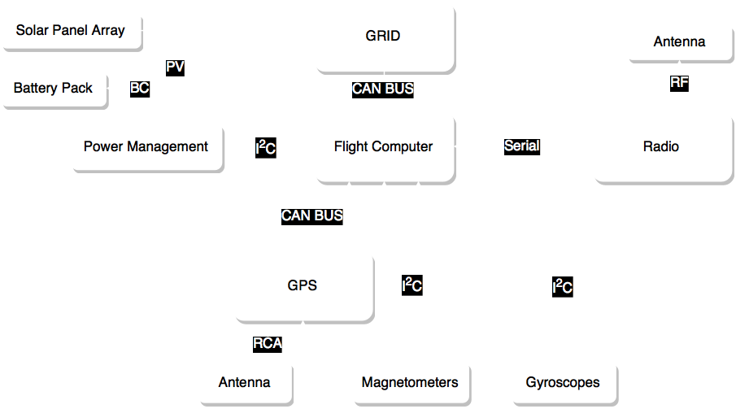
Design - Protocols
Jake G

Slide 23
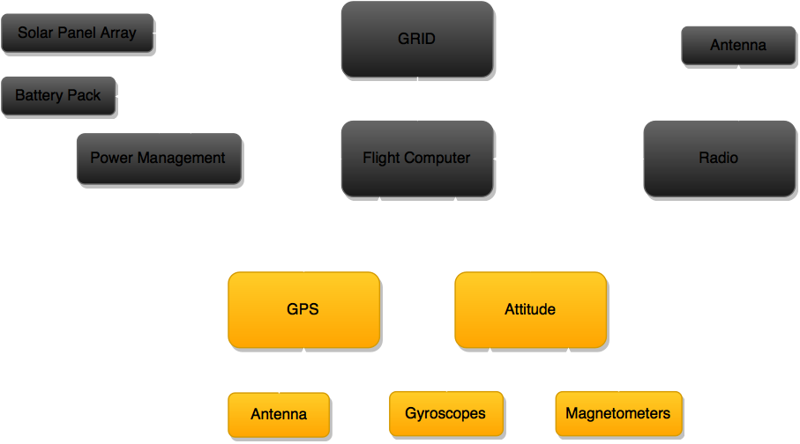
Design - ADCNS

Slide 24
DESIGN - ADNCS Overview
Nick S
Attitude Determination
Gyroscope
Magnetometer
Passive Magnetic Attitude Control
Pointing Accuracy <5º
GPS
Planned Circular Orbit
410Km Altitude
Inclination 60º
Notes:
SLIDE 19

Slide 25
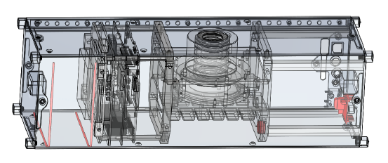
DESIGN ADNCS
X
Nick S
Passive Magnetic Attitude Control
Bar Magnet placed within SOCRATES produces torque to align itself with Earth’s magnetic field
Hysteresis rods damp out oscillatory effects
Why use it?
Proven space heritage
No power required
System consists of:
One 0.3A-m² bar magnet
_____ 0.0268T hysteresis rods 95mmx1mm
All components made from HyMu-80 magnetic alloy
Image from Passive Magnetic Attitude Control for CubeSat Spacecraft, Gerhardt and Palo 2010
Notes:
SLIDE 21, PMAC systems have been successfully used on the University of Michigan’s RAX Cubesat and Colorado’s CSSWE cubesat (Colorado Student Space Weather Experiment)

Slide 26
Design - ADNCS
X
Nick S
System consists of:
One 0.3A-m² bar magnet
_____ 0.0268T hysteresis rods 95mmx1mm
All components made from HyMu-80 magnetic alloy
Verified in Matlab
Settling time of ___ days
GRAPHS HERE
Notes:
SLIDE 22

Slide 27
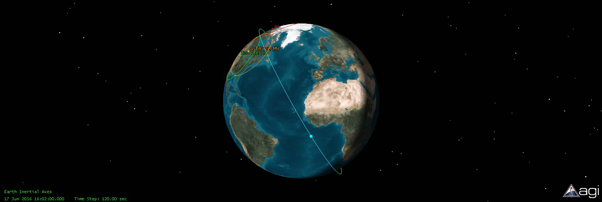
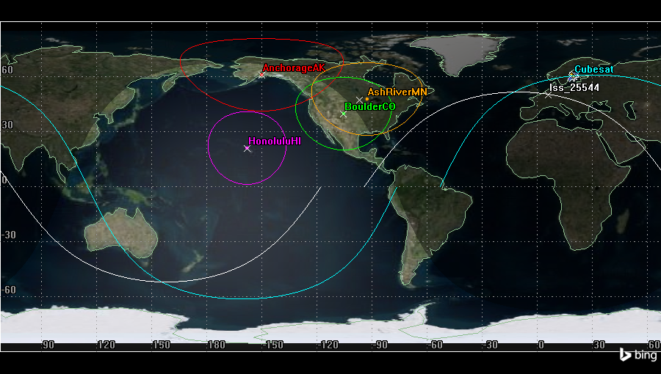
Design - ADNCS
Orbit
Altitude: 410±100 Km
Inclination: 60±10 Degrees
Jake G
Notes:
Moved this slide due referencing STK and orbits before GPS
Orbit uncerinaty is based on testing.
The intial orbit was based on ISS which is shown
However increasing Incliaction gives us more Sunlight time as well as more time, however going over 71 degrees moves us more towards a polar orbit, and then will hurt our sunlight but at 71 it will increase
We could go less Inclination but our data time goes down as well as sunlight time will get smaller, though not by much the Access time will become less and less
As for Altitude we get around the same numbers for adding or subtraction 100km if we go over our Access goes down a lot due to limit range of the Antenna, and going lower 310 we are getting out of leo as its above (220km) however if more is requested we could do more

Slide 28
Design - ADCNS
Jake G
GPS (Novatel 615 with Single Frequency MicroStrip)
Output (50 Hz) (Binary)
GPS Time
GPS Position and Standard deviation
GPS velocity and Standard deviation
Number of Satellites
Space Heritage*
* Provided in supplemental material.

Slide 29
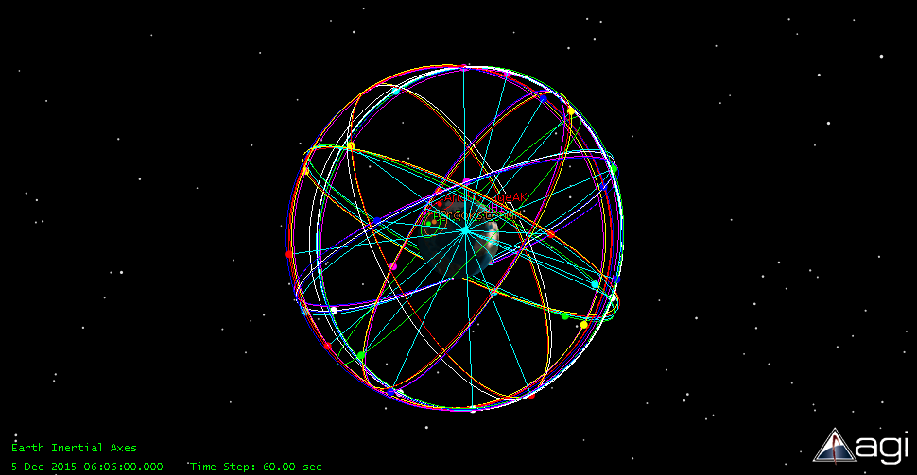
Design - ADCNS
Jake G
Satellite Verification
Need 4 satellites
Verified with STK software

Slide 30
DESIGN ADNCS
Brian H
Attitude determination
Generate 1 vector and use vector matching to determine attitude
Input from gyroscope and magnetometers
High level description
Integrating angular velocity vector gives position
However gyro slowly drifts due to bias error which has no bound!!!
Three axis magnetometer can check accuracy of gyro and “reset” if it drifts too far

Slide 31
DESIGN ADNCS
Brian H
Code Overview
Read gyroscope data
Integrate angular velocity
Determine position
Compare to magnetometer data
If too far
Reset gyro
Else if gyro data above acceptable bound
Reset gyro
End
Compare gyro data matrix, if identity matrix determine overall attitude
Repeat

Slide 32
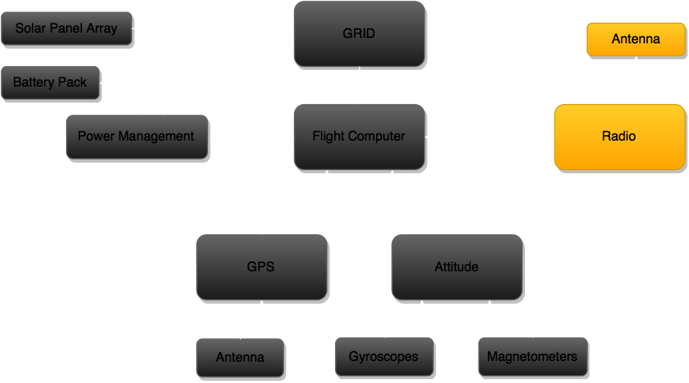
Design - Communications

Slide 33
Design - Communications Overview
Tim K
Maximum total theoretical data that can be transferred per day: 50 MB
Effects that reduce transfer rate
Weather
Communications Algorithm
Random Data Errors
Expected science data transfer per day: 15 MB
Based on calculations
Guaranteed total data transfer per day: 10 MB
Radio data from Aerospace Corp.
Notes:
Predicted assumes 40% weather throughput, maximum expected data errors, and 1 MB of other data transferred per day (handshakes, diagnostics, log files)

Slide 34
Design – Communications Algorithm
Ben S
Step 1: Active Pinging
Check if any other ground stations are currently in contact with SOCRATES
If not, send hail signal once every 3 seconds

Slide 35
Design – Communications Algorithm
Ben S
Step 2: Establish Connection
SOCRATES replies to hail
SOCRATES transmits GPS location, heading, and velocity information
SOCRATES transmits number of files ready for downlink

Slide 36
Design – Communications Algorithm
Ben S
Step 3: Computation
Ground station determines communication time

Slide 37



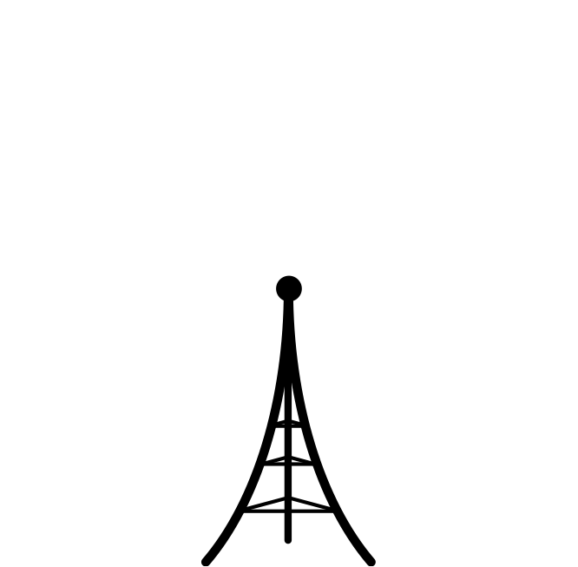

Design – Communications Algorithm
Ben S
Step 3: Computation
Ground station determines communication time
2°
2000 km

Slide 38


Design – Communications Algorithm
Ben S
SOCRATES makes contact
Determine range
Step 3: Computation
Ground station determines communication time

Slide 39
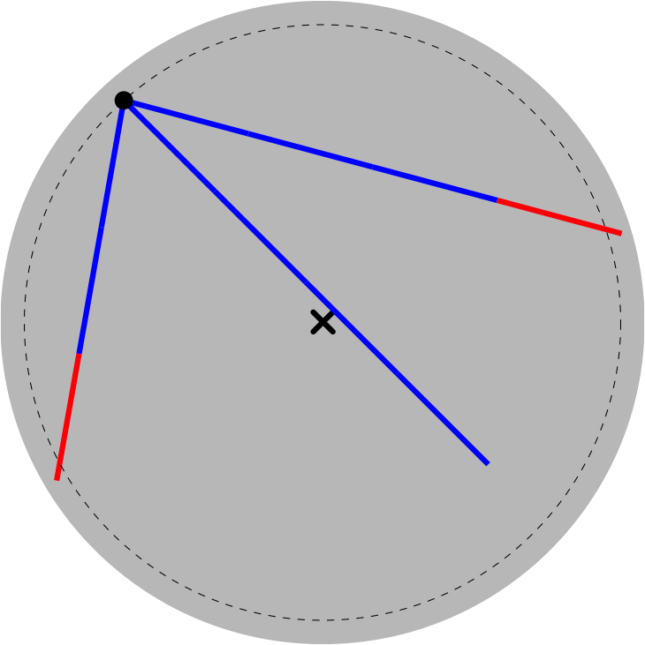
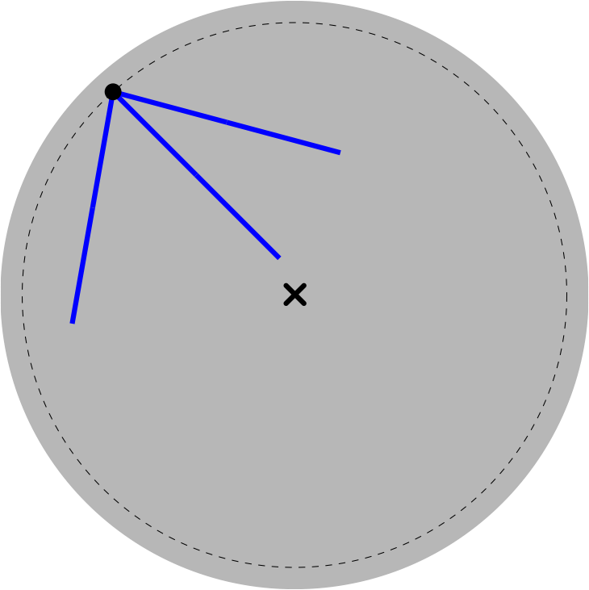
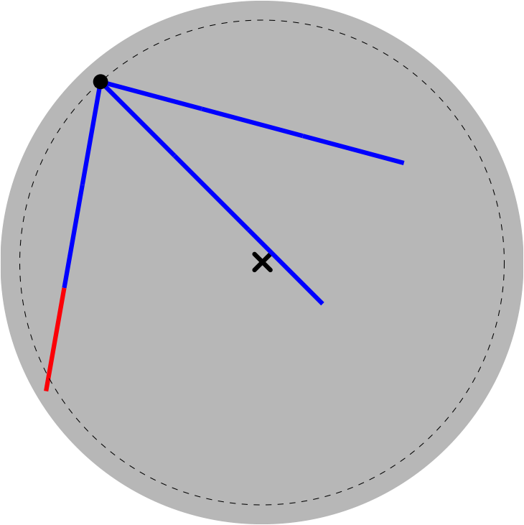
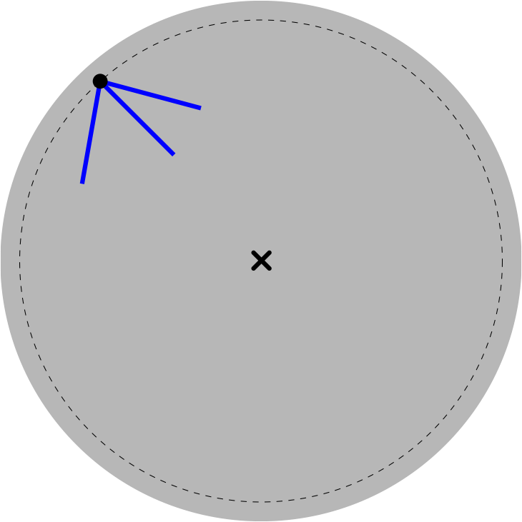
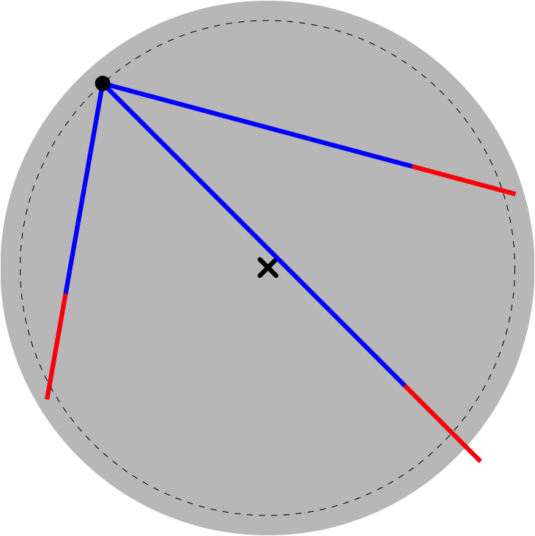
Design – Communications Algorithm
Ben S
SOCRATES makes contact
Determine range
Forward time step
3 second intervals
Step 3: Computation
Ground station determines communication time

Slide 40
Design – Communications Algorithm
Ben S
Step 4: Command
Ground Station sends command code
transfer queued file
transfer log file
diagnostics
delete queued file
delete all data files
SOCRATES purges marked files
delete log file
reboot OS
goodbye
kill

Slide 41
Design – Communications Algorithm
Ben S
Step 5: Transmit Data
SOCRATES transmits one 128 kB packet
5 time steps
Selective Repeat ARQ (Automatic Repeat Query) protocol

Slide 42
Design – Communications Algorithm
Ben S
Step 6: Error Checking
Ground Station computes checksum
Ground Station transmits checksum

Slide 43
Design – Communications Algorithm
Ben S
Step 7: Confirmation
SOCRATES checks checksum
SOCRATES appends log file
SOCRATES marks file for deletion if transmission successful
SOCRATES relays success/failure to ground station
SOCRATES awaits next command

Slide 44
Design – Communications Algorithm
Ben S
Step 4: Command
Ground Station sends command code
transfer queued file
transfer log file
diagnostics
delete queued file
delete all data files
SOCRATES purges marked files
delete log file
reboot OS
goodbye
kill

Slide 45
Design – Communications Algorithm
Ben S
Diagnostics
Onboard Time
GPS Position, Velocity, Satellite Lock
Battery Status, Panel Cell Performance
Attitude Magnetic Lock
Data Storage Check
Detector Diagnostics

Slide 46
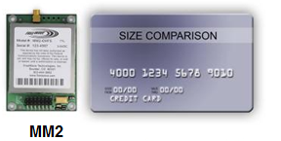
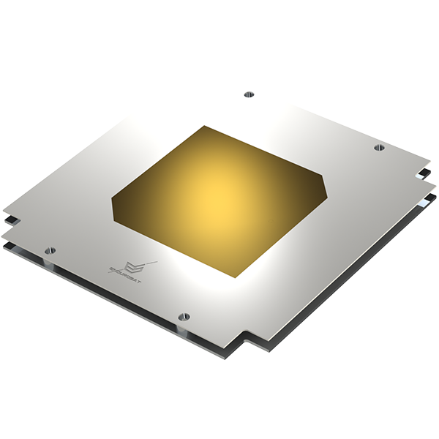
Design - Communications Hardware
Tim K
FreeWave Radio @ 915MHz
Compact radio with high data rate
Radio from Aerospace Corp.
Patch Antenna
Low Profile
Passive control

Slide 47
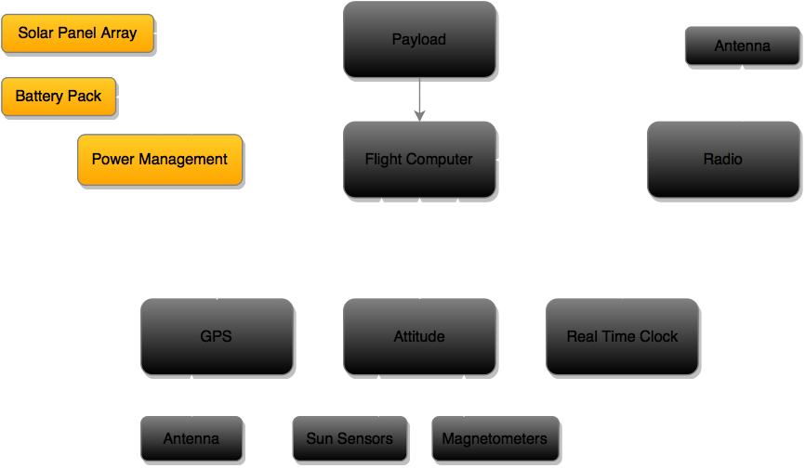
Design - Power

Slide 48
Design – Power
Justin S
Overview
Power Requirements
Supply power for continuous operation of all system components
Remain unpowered through launch, and 45 mins after deployment
Power Supply vs Power Draw
Environmental Factors
Final Power Components
Addition of deployable solar panels

Slide 49
Design – Power
X
Justin S
Component | Power Consumption (Watts)
Payload (GRID) | 5
Flight Computer | 0.33
Magnetometers | 0.06
Gyroscopes | 0.02
GPS Receiver | 0.99
GPS Antenna | 0.3
Radio & Antenna | 0.105 Idle 0.45 Receiving 4.275 Transmitting
EPS | 0.21
Solar Panels | N/A
Batteries | 0.07
Total | 7.085 / 7.43 / 11.26
Power Demands:
Power Supplied Per Orbit:
Battery Operational Range: 77 W – 68 W

Slide 50
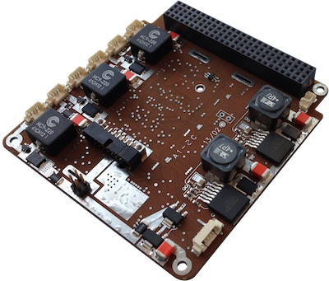
Design - Power
Final Design Components
Power Management Board: P31us – GomSpace
2 regulated Power buses: 3.3V at 5A and 5V at 4A
High and low voltage surge protection
User control of on/off state of bus outputs
4 operating states dependent on battery voltage
Measures/Records:
Current in/out of solar panels
Battery voltage
Voltages into output bus & current out of all power output channels
Temperatures of components
Justin S
*Image provided from GomSpace

Slide 51
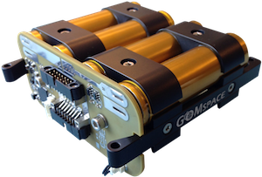

Design - Power
Justin S
Final Design Components
Batteries: BPx – GomSpace
8 ion lithium ion cells
Nominal voltage 12-16.8 V, 5.2 Amps
Operating power capacity 77 W – 68 W
Compatible with P31-us EPS board
*Images provided from GomSpace

Slide 52
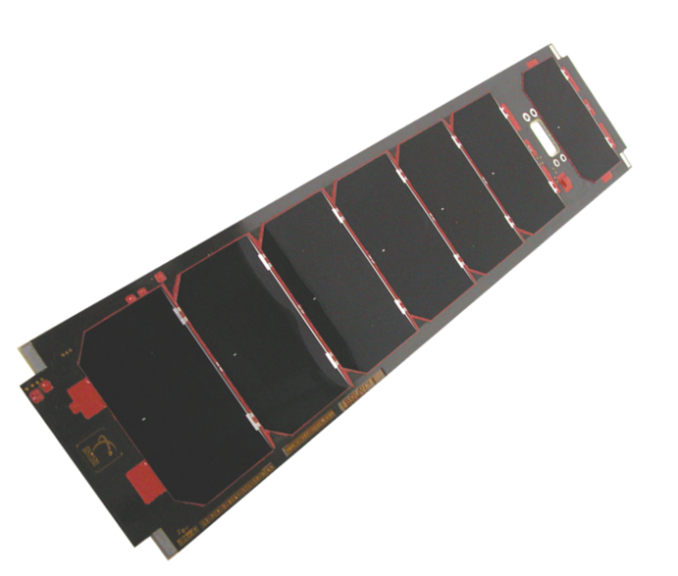
Design - Power
Double sided deployable solar panels
Justin S
Final Design Components
Solar Panels: SP-L-S3U-0016-CS – ClydeSpace
7 solar cells with 28.3% minimum efficiency per 3U side
Integrated temperature sensors
6.26 – 8.63 W produced in -40 – 80 degrees Celsius
Can be integrated with multiple additional sensors
Space heritage with NASA Firefly
2nd 3U side solar panel (reverse side)
3U side solar panel
Delployable Solar Panels: SP-L-DPLS3U-0038 – ClydeSpace
2 double sided deployable solar panels
7 solar cells per side with 28.3% minimum efficiency
130 degree offset from side panels
Dual redundant thermal knifes
Space heritage with Ukube-1 mission
*Image provided from ClydeSpace

Slide 53
Design - Power
X
Nick J
Power order of operations
SOCRATES shall remain powered off from the time of delivery to the launch vehicle through orbit deployment
Following launch, a thermal knife is used to deploy the solar array
Solar power is collected until a minimum voltage is attained 3.3V
Power management board is powered on and begins operation
The power management board controls when the systems are on, and when SOCRATES will be solely charging
No tentative plans to have any systems powered completely off other than the initial launch sequence
Systems will be powered down and the batteries will be depleted as the lifetime of SOCRATES is reached.
SOCRATES then re-enters the Earths atmosphere and is destroyed

Slide 54
Design – Power Budget
X
Ethan A
charge vs discharge

Slide 55
Standards
X
Tim K

Slide 56
FMEA - ADNC
Ben S
Failure Mode | Mechanism | System Effects | Probability | Severity | Risk Level | Mitigation
Gyroscope status read failure | Mechanical failure, software bug | Accuracy loss of attitude solution | Remote | Minor | Low | Test components before launch. Ensure low vibration during launch.
Tumbling | Passive control on only one axis | Communication problems, unexpected internal forces, insufficient power | Moderate | Critical | Unacceptable | Hysteresis rod control.
Lost position information | Could not get 4 GPS satellite lock | Cannot record position | Extremely unlikely | Critical | High | Moved antenna to point away from earth.
Failure to establish magnetic match | Faulty magnetometer read, damage | Reliance on gyroscope for attitude fix | Remote | Not Relevant | Low | Attitude determination no longer needed for mission. No action

Slide 57
FMEA - Communication
Ben S
Failure Mode | Mechanism | System Effects | Probability | Severity | Risk Level | Mitigation
Radio failure | Electrical short, internal damage | Communication is impossible | Remote | Catastrophic | Unacceptable | Test components before launch. Ensure low vibration during launch.
Hard drive failure | Random chance, internal damage | Data storage and retrieval is impossible | Remote | Catastrophic | Unacceptable | Ensure hard drive is space worthy before launch.
Files get stuck in code loop | Software bug, random glitch | Cannot send next file | Extremely unlikely | Moderate | Low | Command failsafes such as clear buffer, load next file, and reboot OS.
Data Transmission Errors | Atmospheric effects, noise | Incorrect data received | Nearly certain, frequent | Moderate | High | Error checking: Selective Repeat Automatic Repeat Query protocol during transmission, and overall checksum post packet send.

Slide 58
FMEA - Power
Ben S
Failure Mode | Mechanism | System Effects | Probability | Severity | Risk Level | Mitigation
Solar panels fail to deploy | Thermal knife | Not enough power, no mission | Remote | Catastrophic | Unacceptable | None.
Battery underload | Battery failure/dead | No battery power, system only on when solar panels illuminated | Moderate | Moderate | Moderate | Programmed software cases. Report problem in diagnostics.
Battery overload | EPS fails and overloads battery | Explosion | Remote | Catastrophic | Unacceptable | Test component before launch.

Slide 59
Conclusion
X
Nick S
Delivered:
SOCRATES Hardware Design
Planned and Orbit
Verified Attitude Control
Notes:
SLIDE 49

Slide 60
What’s next?
Brian H
Here are the next steps to be done in spring.
Revisit calculations and designs, revamp etc…
Finalize design.
Iterative process
Build testbeds and verify at high altitude
GPS
Attitude Determination
Power simulation board
HASP Mission in Summer
Use this opportunity to “fly” SOCRATES prototype

Slide 62
Individual Reports

Slide 63
Lessons Learned
Ben
Things take a lot longer to do than they seem they should
Lot’s of very smart people have already worked out similar problems
It’s okay to ask questions
Recycle their ideas
Open source code is readily available
Proprietary information is frustrating
STK makes life a whole lot easier
The atmosphere is a pain
Data is always available for all frequencies except the one you are working on
Pocket calculator is sometimes more reliable than the code you wrote
Double/triple check everything
Write stuff down because it’s hard to find again

Slide 64
Individual Design Contributions
Ben
Communication Hardware
Initial literature search
Data-Link Budget
Preliminary Power Calculations
Data Transmission Error Estimations
Verification
Orbit Determination
Altitude and inclination
Timing study
Data allowance for GRID
Communication Algorithm
Studies of existing protocols
Data management requirements
Error considerations
Packet size determination
Checksum
Timing estimations
Algorithm sketch

Slide 65
Design – Data Link Budget
Ben
Driving Questions:
Can data be successfully transmitted to Earth?
How much error can be expected?
Link Budget examines power losses and gains during emission, transmission, and detection of signal
Logarithms make calculations easier
Estimate ground stations at sea level

Slide 66
Design – Data Link Budget
Ben
Equivalent Isotropic Radiated Power (EIRP)
EIRP (dBW) = Antenna Power (dBW) + Antenna Gain (dB)
For SOCRATES, EIRP = 1.14 dBW
Power = 1.3 W
Whip antenna assumed omnidirectional, so gain = 0 dB

Slide 67

Design – Data Link Budget
Ben
Free Space Losses
Dominant component of losses
Power flux density falls off as 1/r²

Slide 68
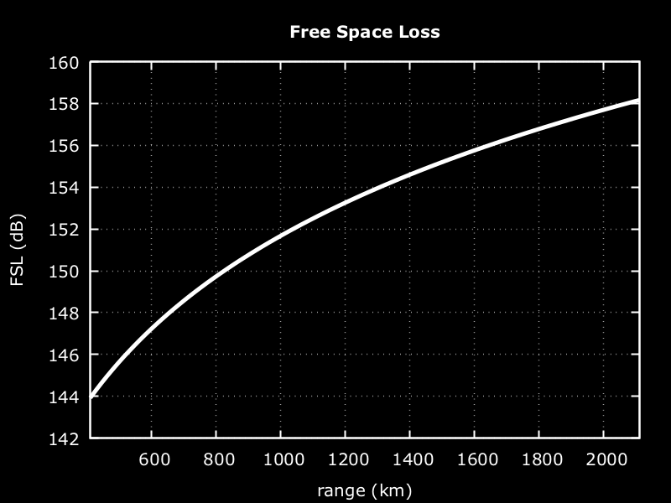
Design – Data Link Budget
Ben
FSL = 158 dB for link budget calculation

Slide 69
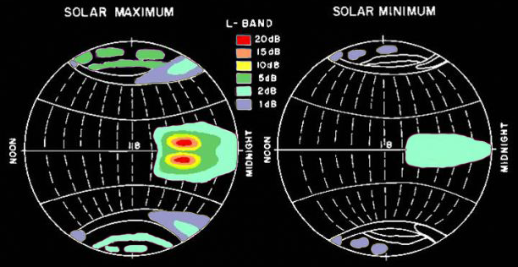
Design – Data Link Budget
Ben
Atmospheric Losses
Ionosphere
Faraday Rotation - assuming circular polarization, negligible effect
Scintillation, mid-latitudes (<1 dB)
Adapted from: Istituto Nazionale di Geofisica e Vulcanologia, Roma2 Department, Aeronomy
URL: http://roma2.rm.ingv.it/en/themes/11/ionospheric_scintillation

Slide 70
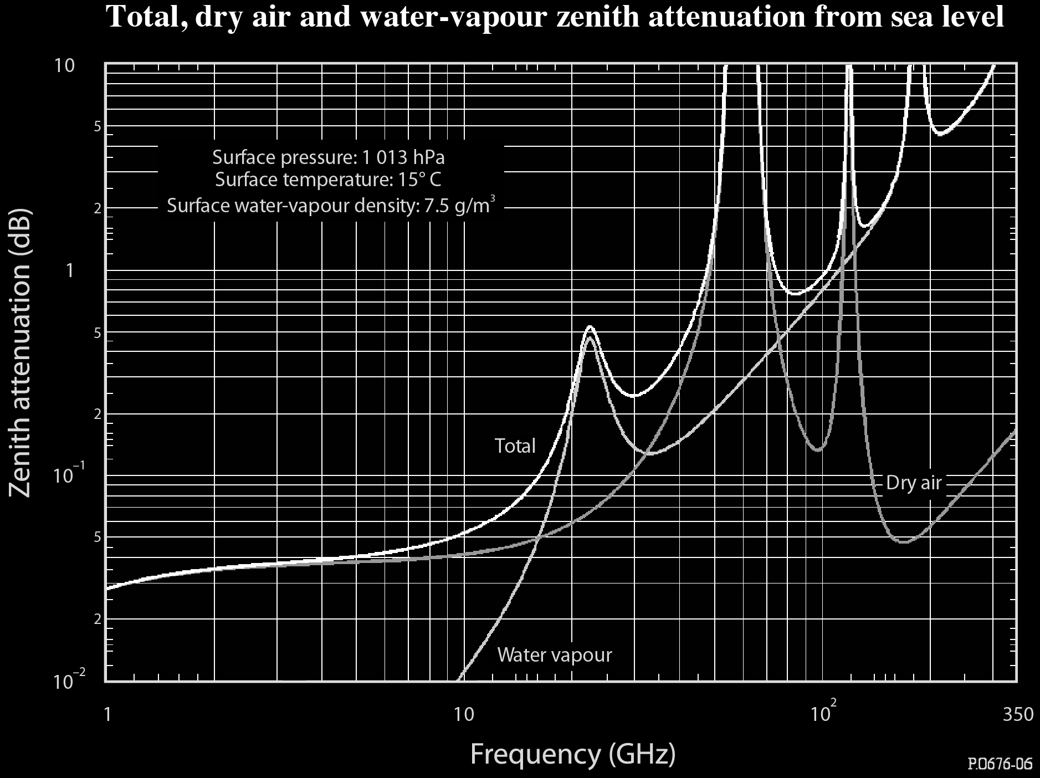
Design – Data Link Budget
Ben
Atmospheric Losses
Ionosphere
Faraday Rotation - assuming circular polarization, negligible effect
Scintillation, mid-latitudes (<1 dB)
Troposphere
Extrapolation to 915 MHz
Zenith attenuation = 0.025 dB
TL_{max} = 0.025 dB × csc(2°) = 0.72 dB
Adapted from: International Telecommunication Union, Recommendation ITU-R P.676-9

Slide 71
Design – Data Link Budget
Ben
Atmospheric Losses
Ionosphere
Faraday Rotation - assuming circular polarization, negligible effect
Scintillation, mid-latitudes (<1 dB)
Troposphere
Extrapolation to 915 MHz
Zenith attenuation = 0.025 dB
TL_{max} = 0.025 dB × csc(2°) = 0.72 dB
Other Losses
Weather conditions (e.g. rain)
Depolarization (~2 dB)
Temporary effects (ignore)
Total estimated atmospheric loss
AL = 3 dB
Notes:
Depolarization ice and rain International Radio Consultative Committee (CCIR)

Slide 72
Design – Data Link Budget
Ben
Pointing Losses
Off-axis loss at CubeSat
Dependent on final satellite design, (< 1 dB)
Off-axis loss at Ground Station
Generally small (< 1 dB)
Antenna orientation misalignment
Depolarization, assuming circular polarized transmission, theoretical max 3 dB.
Estimated pointing loss
PL = 4 dB

Slide 73
Design – Data Link Budget
Ben
Noise
Thermal Noise
Sky Noise
Ground Noise
NEED TO RE-WORK

Slide 74
Design – Data Link Budget
Ben
Putting it all together
Ground station signal gain
AG = 30 dB
Power received at ground station
P_{r} = EIRP – FSL – AL – PL + AG
P_{r} = 1 dBW – 158 dB – 3 dB – 4 dB + 30 dB = -134 dBW = 40 fW
Notes:
Equivalent Isometric Radiated Power minus propagation losses
GA gain ground antenna 30 dB
Ebno = energy per bit divided by the noise spectral density
B = bits/sec bitrate

Slide 75
Design – Data Link Budget
Ben
Putting it all together
Signal to noise
P_{r} = 40 × 10 ⁻¹⁵ W
B = 115 kbps
k_{B} = 1.381 × 10 ⁻²³ J/K
T = yet to be determined
Bit Error Probability
E_{b}/N₀ = ?
P_{e}= Something
Notes:
Equivalent Isometric Radiated Power minus propagation losses
GA gain ground antenna 30 dB
Ebno = energy per bit divided by the noise spectral density
B = bits/sec bitrate
Erfc = complimentary error function

Slide 76
Design – Data Link Budget
Ben
Aerospace’s ADV radio and ground network
Proven downlink 10-15 MB per 24 hour period for LEO satellite (TRL 9)
AsterLabs comparison
Same operating frequency (914.7 Hz)
Closed link-budget with 1.2 W antenna at 650 km altitude
10 MB per 24 hour period
Notes:
TRL – Technology readiness level

Slide 77
Individual Design Contributions
Justin S
Initial Power Requirements
Power Components and Space Heritage
GomSpace vs ClydeSpace
Product Research & Determination
Solar Panel Configuration
Power Supply and Budget Modeling

Slide 78

Individual Design Contributions
Power Budget Modeling
1.5 hour orbit period
0.98 hour sunlight period
1 degree/ 15 seconds
6.26 W/h efficiency at 80 degrees Celsius
Took percent offset from perpendicular position relative to sunlight, and calculated wattage per second in that position. Added for total sunlit orbit for each solar panel.
~ 10.5 – 13 W gained per idling orbit, ~ 12.7 W per transmitting orbit
118
163
73
208
28
236
0
Unlit portion of orbit

Slide 79
Lessons Learned
Justin S
Teams are most efficient when there is good communication
Best way to communicate is having everyone working together in same location/time
Well organized documentation is key to team’s success
Strong leadership is more critical than most people think
Outside obligations take away from the quality of the project
There’s always something you missed or don’t fully understand about a project. Review data sheets multiple times. If you think you understand a product within the first hour of reviewing it… you probably don’t truly know half of it
Sometimes your theoretical calculations are the best results you can get
Everyone will have their separate way of modeling a situation
Look for provided sources before you attempt to calculate everything for yourself

Slide 80
Lessons Learned
Nick J
Redundancy in design is imperative
Computer software is nice, but don’t lose faith in your own calculations
Power determination in space is challenging
Time management skills
Balancing a long term project proved more challenging than I had initially though
Creates a need to prioritize
Learning is life-long

Slide 81
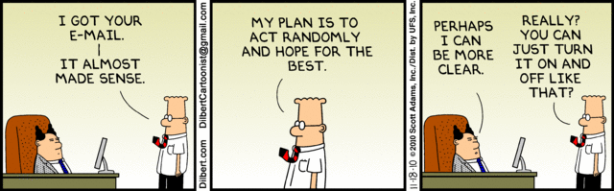
Communication
Nick J
Established a foundation of teamwork amongst SOCRATES subteams
Made it simpler to ask for help
Willingness to step out of comfort zone to assist teammates with engineering tasks
Presented a platform to convey ideas and motivations individually, but with a common end goal
Established relationships within industry
Company consulting for item specifics

Slide 82
Individual Design Contribution
Nick J
Structure Contributions:
Performed thermal analysis throughout the orbit using STK SEET (Space Environment and Effects Tool)
Used to determine surface temperatures and required heat shielding
Studied the lighting, penumbra, and umbra durations for a broader understanding of the solar power available, as well as the thermal activity during orbit
Power Contributions:
Performed case studies for needed components
Evaluated the options available to select the correct components to satisfy the needs of the other subsystems depending on power consumptions
Worked with other team members to create a power budget for SOCRATES
Calculated internal energy dissipation (0.32 W)
General research on various different systems and power requirements
Individual Time Commitment: ~6hrs/week , 16 weeks, ~96 hours

Slide 83
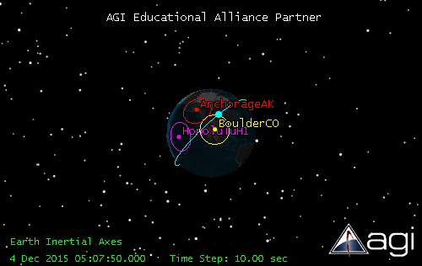
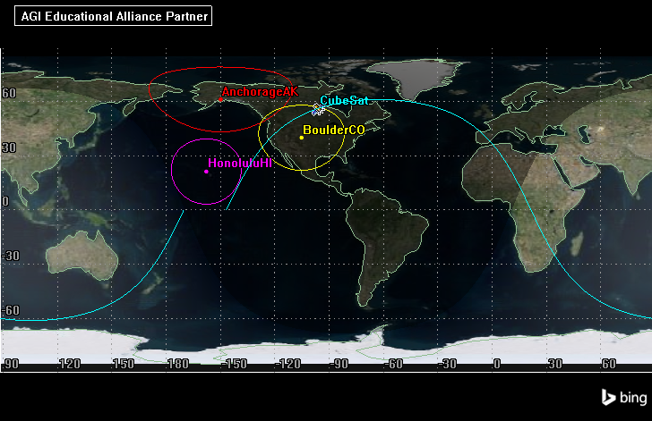
Engineering Methodology
Nick Janak
Studied material properties to determine a passive method of thermal control
Absorptivity and Emissivity of materials on SOCRATES surface
STK SEET (Space Environment and Effects Tool)
In addition to the shared files from Jacob’s STK analysis
Analysis of the incident radiation
Analysis of Space Vehicle temperatures

Slide 84
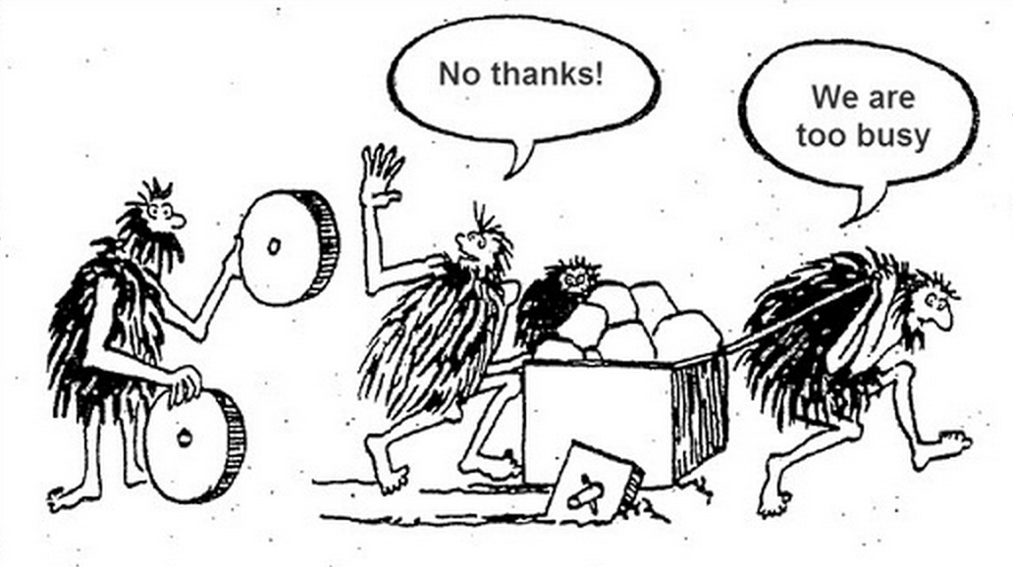
Lessons Learned
Jake G
don't reinvent the wheel
You can never know too much
Don’t be afraid to ask
(its okay to not know everything)
Double Check EVERYTHING!!!!!!!!!!!!
Remember to have fun
But only so much
https://trimaps.com/custom-map-users/interactive-map-made-easy-for-developers

Slide 85
Individual Design Contributions
Jake G
GPS
Parts Choice
Antenna Choice
Attitude determination
Initial Research on Algorithm
STK
Hours: ~100

Slide 86
STK
Jake G
Used for on CubeSat
Model
Power Budget
Link Budget
GPS Verification
Very Powerful
Not just used for Space Applications

Slide 87
Individual Design Contributions
Nick S.
Attitude determination
Initial research into hardware
Passive Magnetic Attitude Control System
Research
Materials Sourcing
Matlab simulation and verification
Notes:
SLIDE 64, Magnets are annoying.

Slide 88
Lessons Learned
Nick S.
Importance of Consistency
Being gone for ~1 month on a 3-month projects makes things difficult
Organization makes your life easier
People want to help (so ask questions)
Space is difficult
Never stop learning
Notes:
SLIDE 65, Leaving for Australia took me out of the loop for the project and I had to spend time catching up with where things were. Keeping things together an organized makes things happen. You don’t design in a vacuum. Ask people and you can find help. One paper from our sponsor allowed me to create a matlab simulation to verify our PMACS. Putting something in space makes all of your challenges that much tougher. Orbits, reliability, power; all become really hard when you have zero-margin for failure. I also learned that in space things get hot and cold. I knew that, but never the magnitude of the variation.

Slide 89
This slide intentionally left blank.

Slide 90
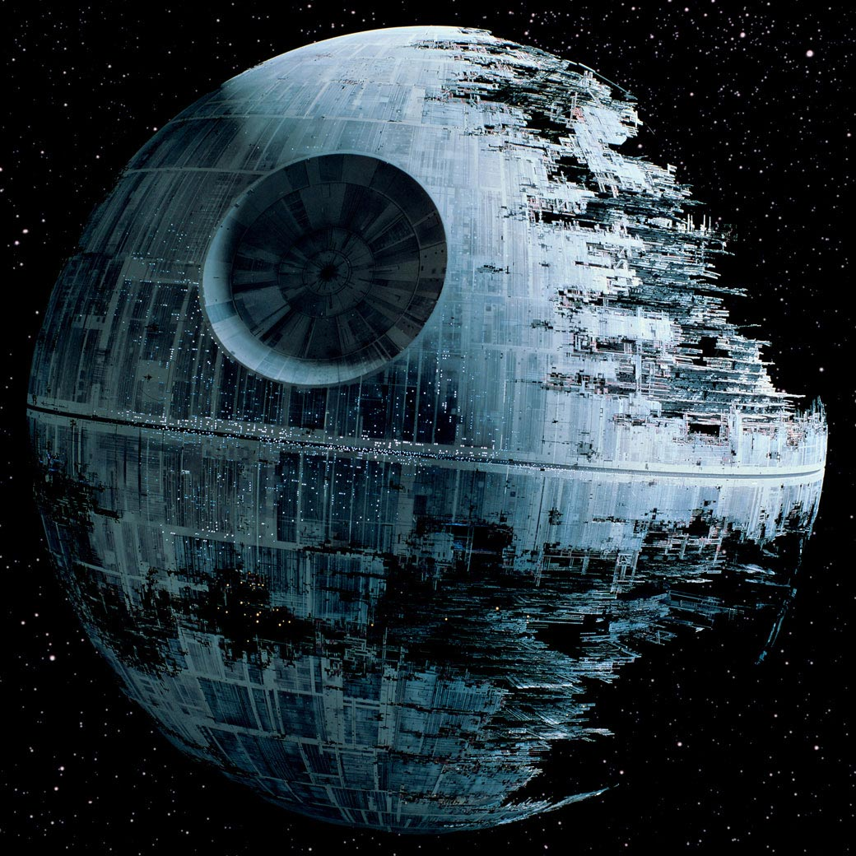
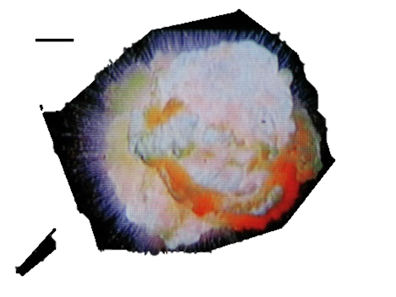
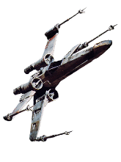
THE END
This slide intentionally left blank.

